Slide 1
Lawyer Connect: Find Your Legal Expert
Submitted By:
MD. BENJIR HASAN (20-43494-1)
SHANTO KUMAR BASAK (20-42945-1)
UDAY KUMAR SARKER (20-42941-1)
SALIMA FARAH (20-42497-1)

Slide 2
Index
Introduction
Problem Domain
Solution for Problem
Software Description
Solution Description
UML Diagram
Social Impact
Development Planning
Marketing planning
Cost and Analysis
conclusion

Slide 3

Introduction
Complex legal landscape
Challenges for individuals
Lack of accessibility
Absence of streamlined mechanism
Need a transformative solution

Slide 4

Problem Domain
Background problem
Root cause
Importance

Slide 5

Solution for Problems
Short listing verified lawyers with their expertise in different law domain qualifications and client review
Creating a search tool that will provide the best lawyer by their requirements with geographical proximity, availability and other criteria.
Offering an appointment booking mechanism which helps users to connect with their respective lawyer and schedule consultation via this platform also offering the choice of online or in-person meeting.
An user-friendly interface that can help user by navigating and utilization for clients.

Slide 6
Software Description
a web or app-based system designed to streamline the process of discovering and reserving lawyer appointments in Bangladesh.
The software's principal objectives encompass enhancing access to justice by simplifying the identification of capable and reliable legal professionals and also provide services to small and medium-sized enterprises.
offer users access to a repository of accredited lawyers proficient in various legal domains.
facilitate the direct scheduling of appointments with lawyers, thus circumventing the necessity for telephonic correspondence or physical visits to legal establishments.

Slide 7

Solution Description
System Features
Lawyer Database
Appointment Booking system
User management
Lawyer management
Payment system
Search engine optimization (SEO)
Notification system
Feedback system
Reporting system
Integration with external services

Slide 8
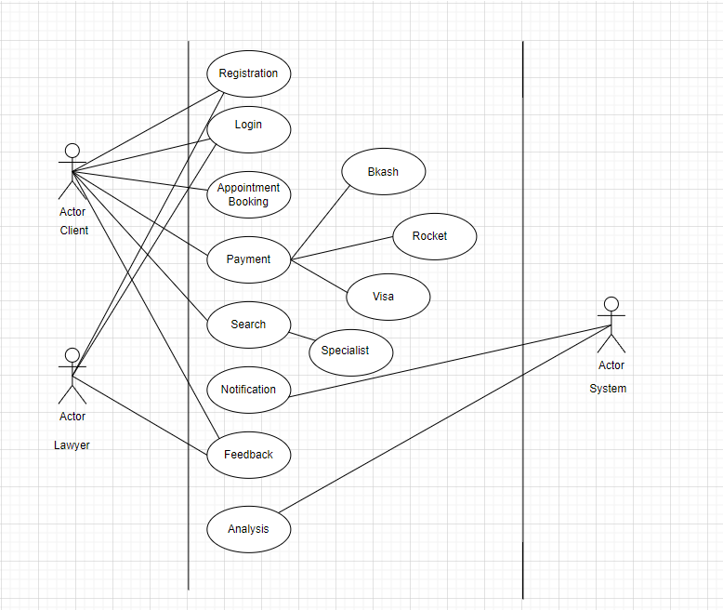
UML Diagrams
Use-case Diagram

Slide 9
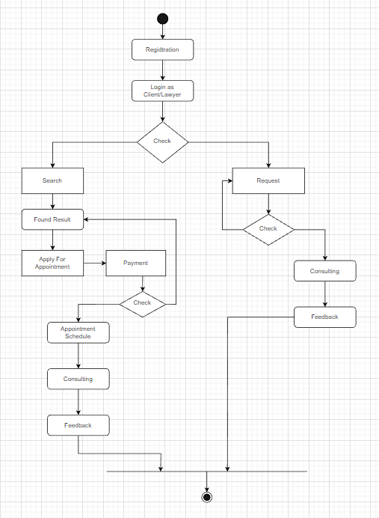
UML Diagrams (cont..)
Activity Diagram

Slide 10
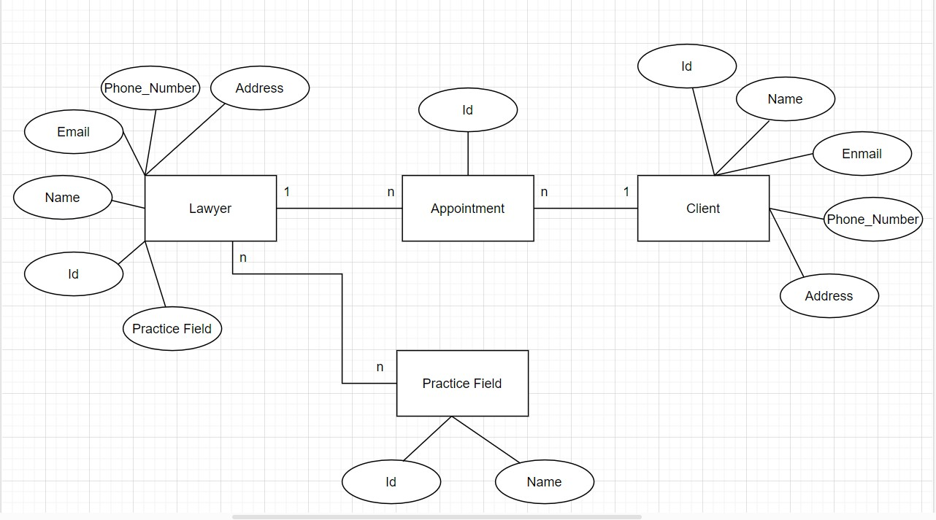
UML Diagrams (cont..)
E-R Diagram

Slide 11

Social Impact
Enhanced Access to Legal Services
Efficiency and Time Savings
Cost Reduction and Increased Productivity
Transparency and Accountability
Advocating Trust and Quality

Slide 12

Development planning
Project plan:
Create project chart
Finalize charter and obtain approvals
Project planning
Formulate project control strategy
Design phase
Development phase
Testing phase
Implementation stage
Close project

Slide 13

Market Planning
Short-term strategy
Long-term approach
Continuous initiatives

Slide 14

Cost and Profit Analysis
Development Cost:
Development team salaries: BDT 1,00,000 per month (for 6 months) = BDT 6,00,000
Server and hosting costs: BDT 50,000 per month (for 6 months) = BDT 3,00,000
Other development costs (e.g., software licenses, third-party APIs): BDT 1,50,000
Total development cost: BDT 10,50,000
Marketing Cost:
Social media advertising: BDT 10,000 per month
Search engine optimization (SEO) services: BDT 5,000 per month
Other marketing costs (e.g., events, partnerships): BDT 25,000 per month Total marketing cost: BDT 40,000 per month

Slide 15
Cost and Profit Analysis
Revenue:
Assuming an average appointment fee of BDT 500 and 1000 appointments per month, the monthly revenue would be: BDT 500 x 1000 = BDT 5,00,000
Profit:
Total profit = Total revenue - Total cost
Total cost = Development cost + Marketing cost
Total cost = BDT 10,50,000 + (BDT 40,000 x 6) = BDT 12,90,000
Total revenue = BDT 5,00,000 x 6 = BDT 30,00,000
Total profit = BDT 30,00,000 - BDT 12,90,000 = BDT 17,10,000
Investment Return:
Assuming investors are interested in a 10% return on their investment, the amount of investment required would be:
Investment = Total cost / (1 - Investment return rate) Investment = BDT 12,90,000 / (1 - 0.1) = BDT 14,33,333.33

Slide 16
Conclusion
We generally want to solve the ultimate problem that usually faced in the court for general people.
Make a systematic way and an user friendly approach to solve the lawyer issue.
Try to make a remarkable evolution in law and lawyer relationship with general people services.
There are some future scopes that would be developed further research and development.

Slide 17


